Slide 1

I N T E R N S H I P
PRESENTATION
Fujikura Electronic (Thailand) Ltd. Northern Region Industrial Estate - Lamphun

Slide 2


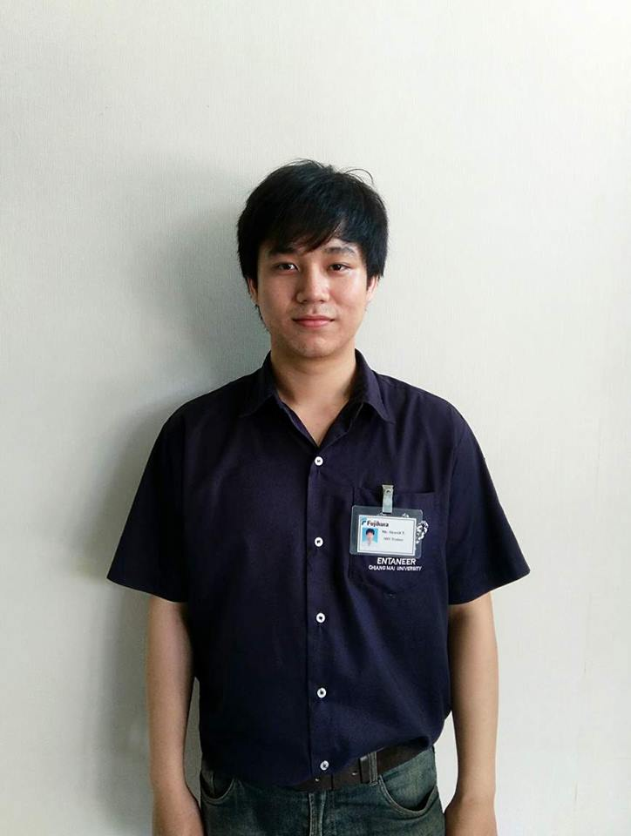
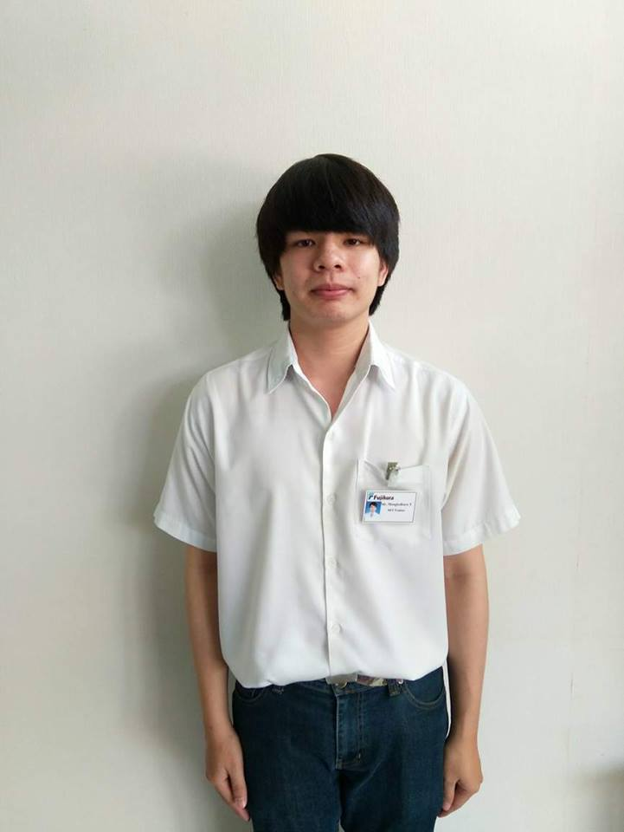
SIRAWIT TAKAEW #JIMMY
INTERNSHIP AS A MIT TRAINEE
MONGKOLKARN TONDE #PAE
INTERNSHIP AS A MIT TRAINEE
Around 2 months
1 June to 27 July

Slide 3

O B J E C T I V E
Applicability from lecture to career
Enhances of the academic experience
Career direction
Communication skills
Problem solving skills

Slide 4

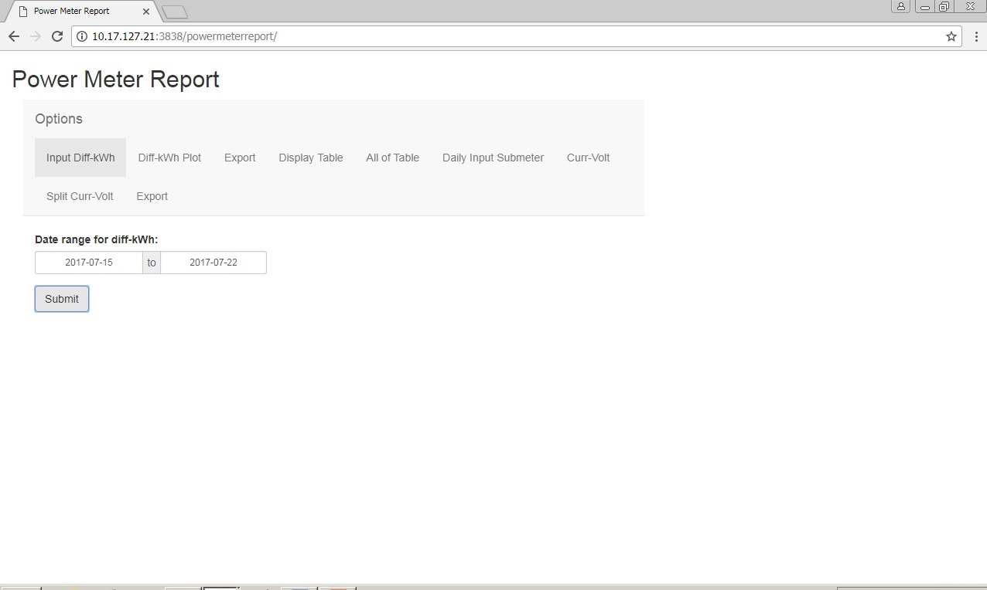
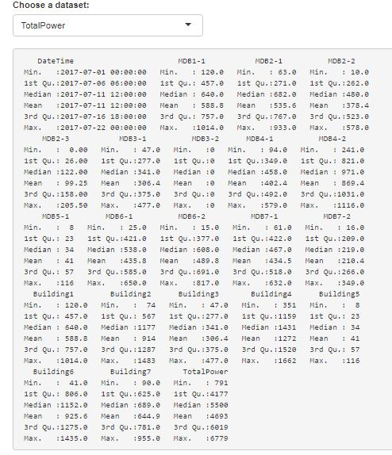
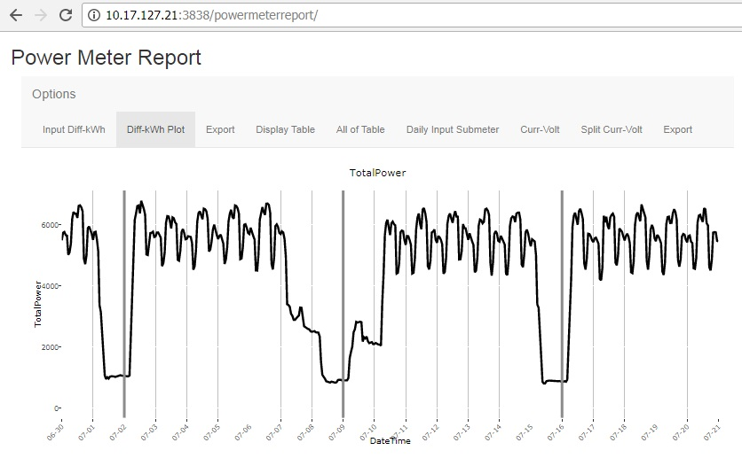
POWER METER REPORT
Web application
EFFICIENCY but SIMPLE.

Slide 5
P R O C E S S
# REQUIREMENTS
# DESIGN
# IMPLEMENTATION
# VERIFICATION

Slide 6
REQUIREMENTS
A web application displays plots
about main power meter's diff-kWh with analysis.

Slide 7
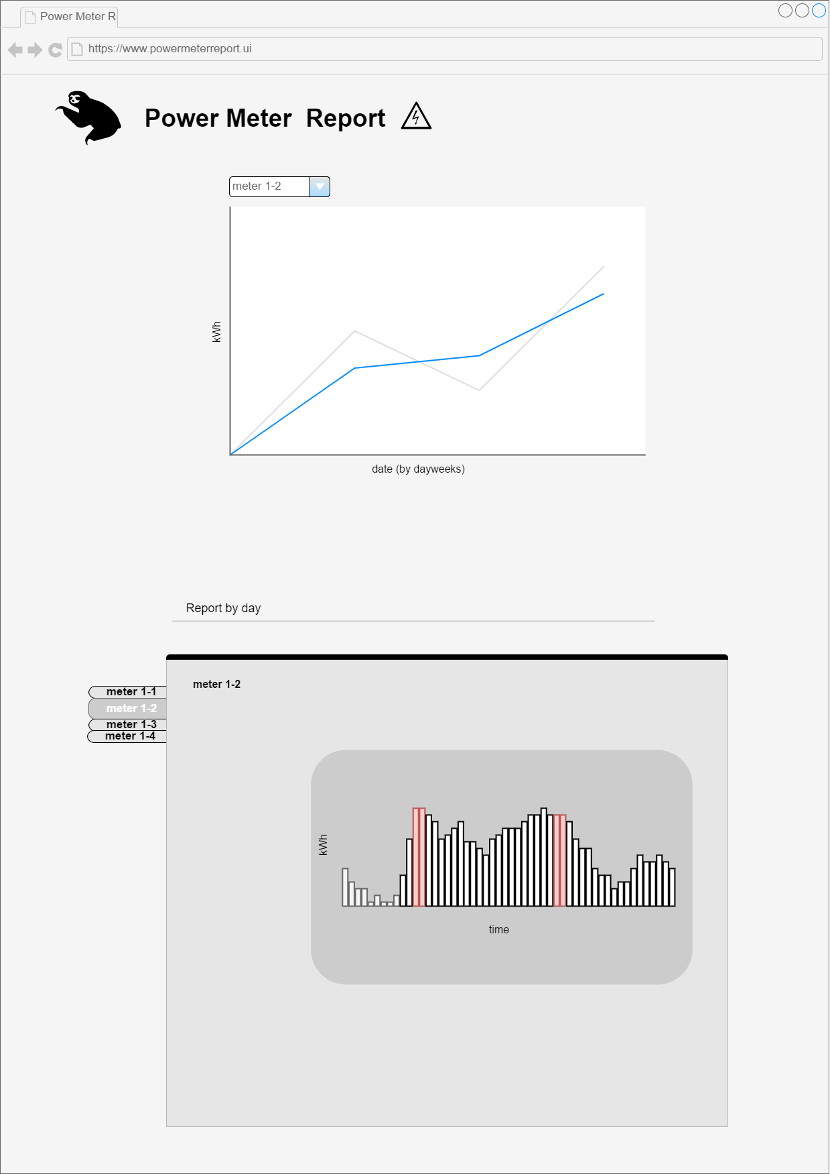
DESIGN

Slide 8
IMPLEMENTATION
Do SQL query data. - Do data preprocessing.
(Just done data preparation but during work in process was having a meeting and getting new requirements.)

Slide 9
REQUIREMENTS #2
A web application displays plots
about main power meter's diff-kWh and sub meter's voltage-current minutely thorough report.

Slide 10
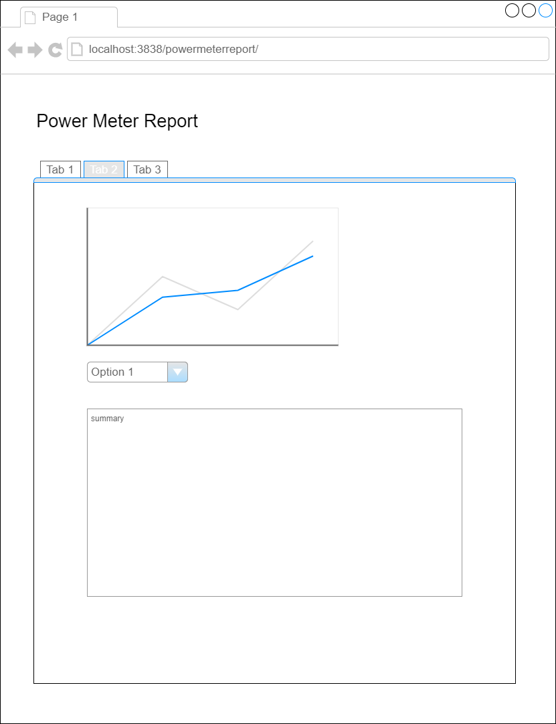
DESIGN #2

Slide 11
IMPLEMENTATION #2
Split analysis visualization out for only education. - Go on developing web application by using Shiny web application package. - Add exporting data table after data filtered by *.CSV and plot by *.PNG.
- Do reactive data plot. - Simulate web server by Linux using Terminal bash all things and deploying web to server
before install the real web server.

Slide 12
VERIFICATION
User testing for feedback and get new a little requirements to add sub meter's daily diff-kWh data.

Slide 13

P R O B L E M S
&
S O L U T I O N S

Slide 14
GENERAL
Something takes too long time for tutorial and hard to understand.
> Ask supervisor suggestions.
Found meter being out of order or broken
from missing or improper values.
> Tell supervisor or PE department.

Slide 15
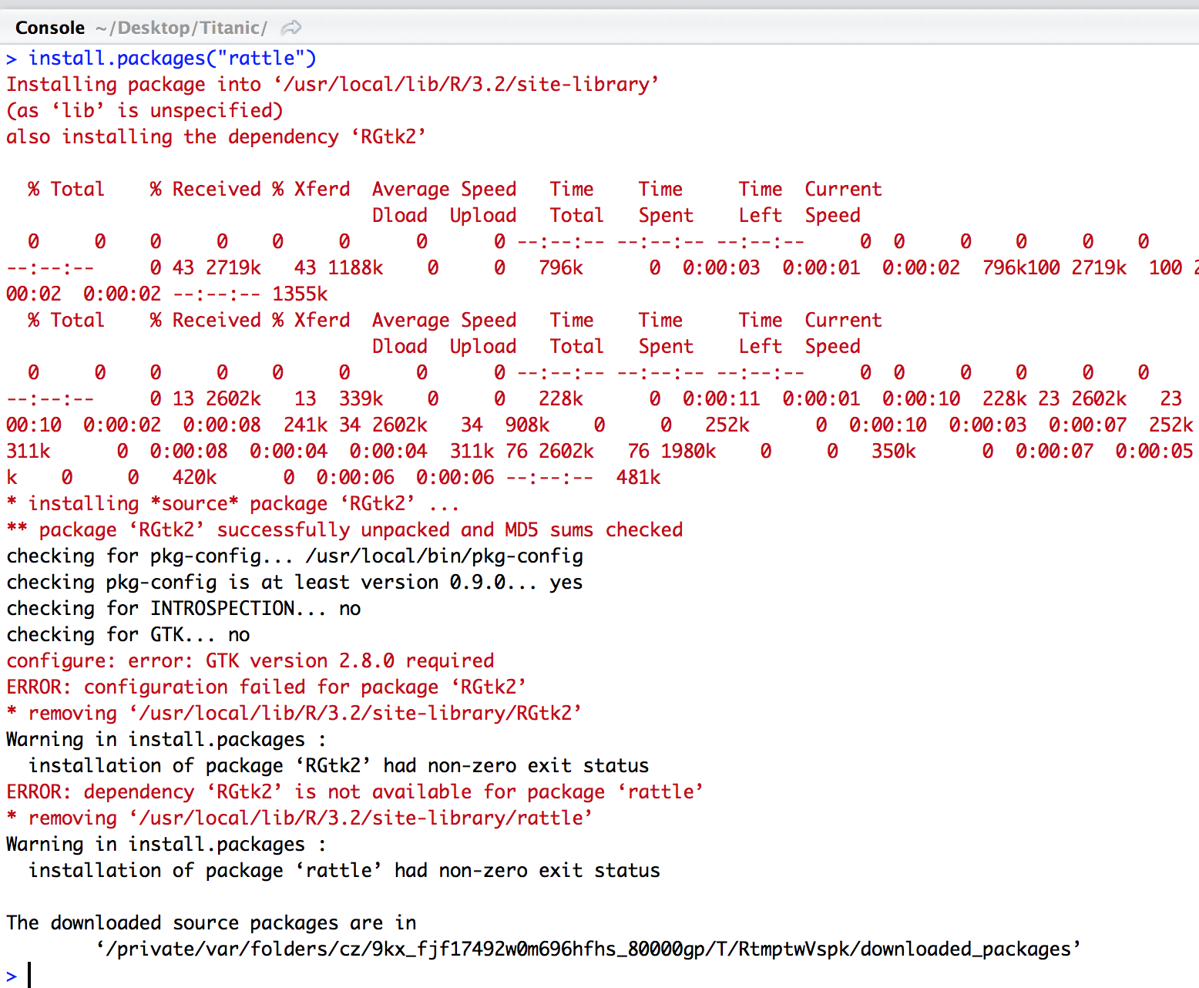
Can’t fix the error.
$ Find another way more safe coding
and ask stack overflow.
DEVELOPING
Wrong timezone making time shifted 7 hours.
$
Check packages or functions' timezone default which one should set "Asia/Bangkok" or "UTC" to.
Lots of missing values and accumulated after got diff-val.
$
Filter data again and bin proper values.

Slide 16
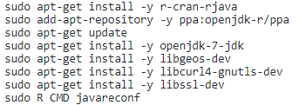
DEVELOPING
Different format between Windows and Linux platform.
$
Create function displaying texts returning values.
Linux has many packages related.
$
Check and install carefully till completely.
Shell script is very complicated and error
$
Do normal bash.

Slide 17

# SQL Query on MSSQL Server
# R on Rstudio
# Bash on Ubuntu 16.04 simulated in Oracle VM VirtualBox
# VB.NET on Visual Studio
TOOLS
# Git on github.com
# Remote the server by VNC Viewer
Integrated Development Environment

Slide 18
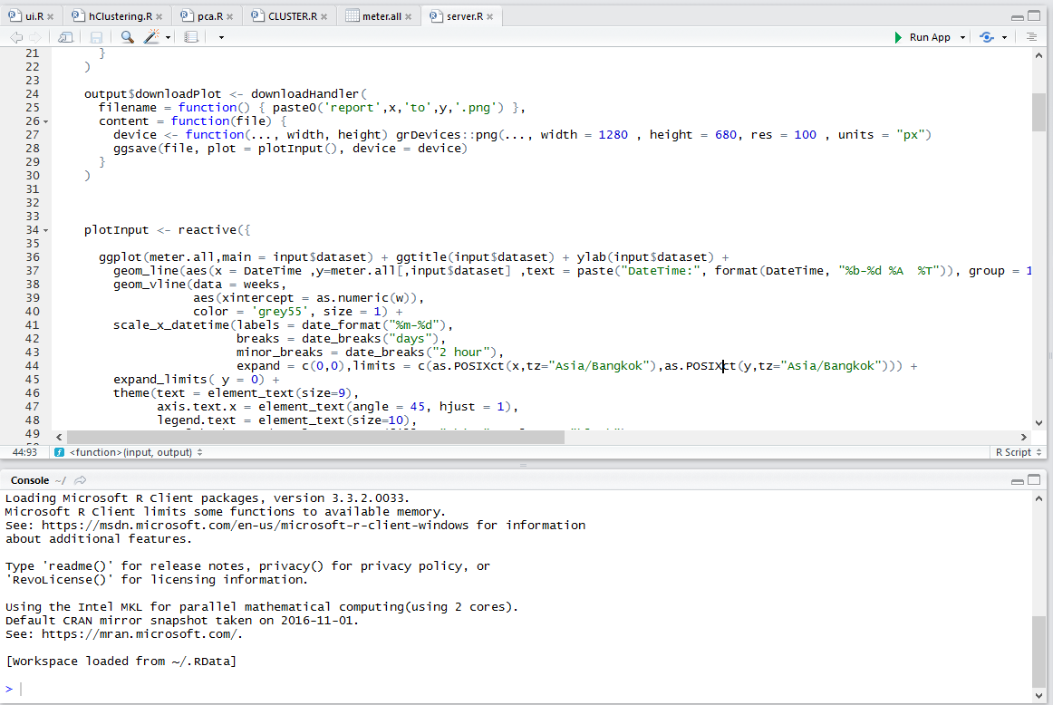
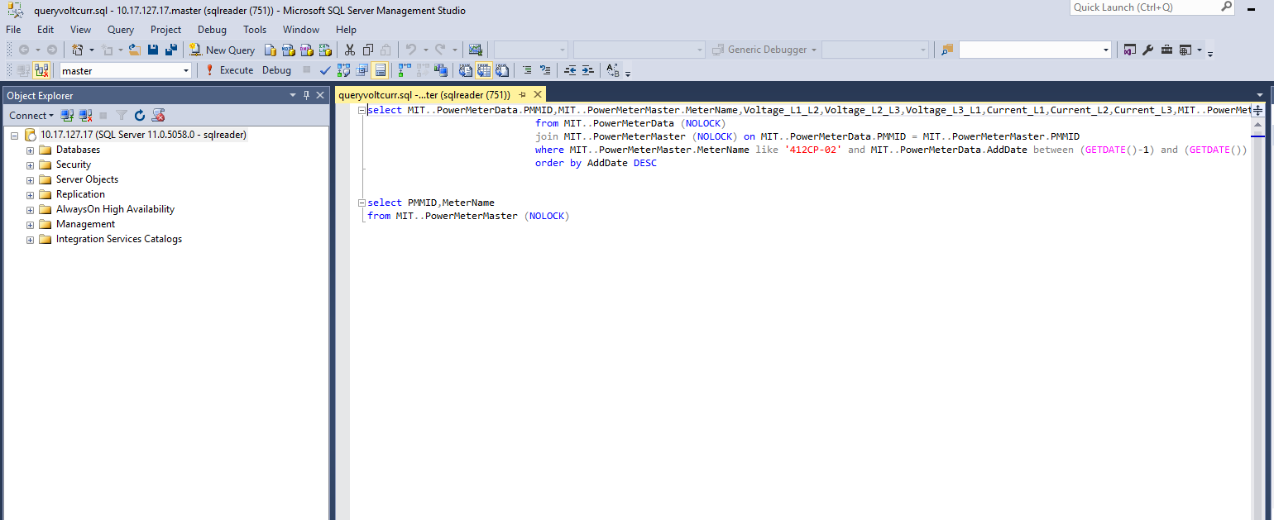
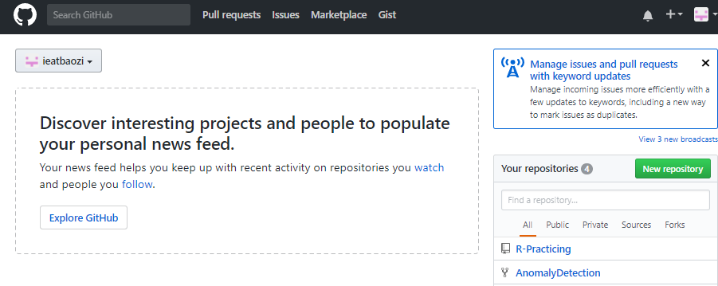
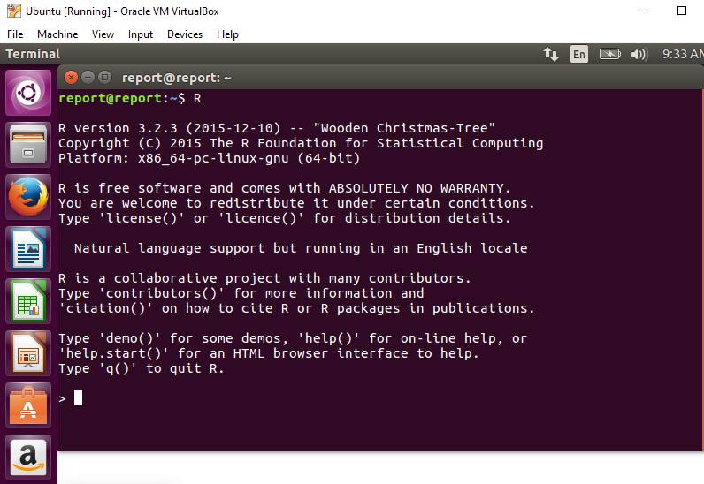

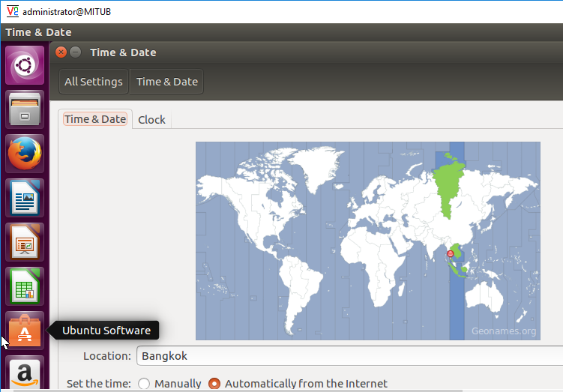
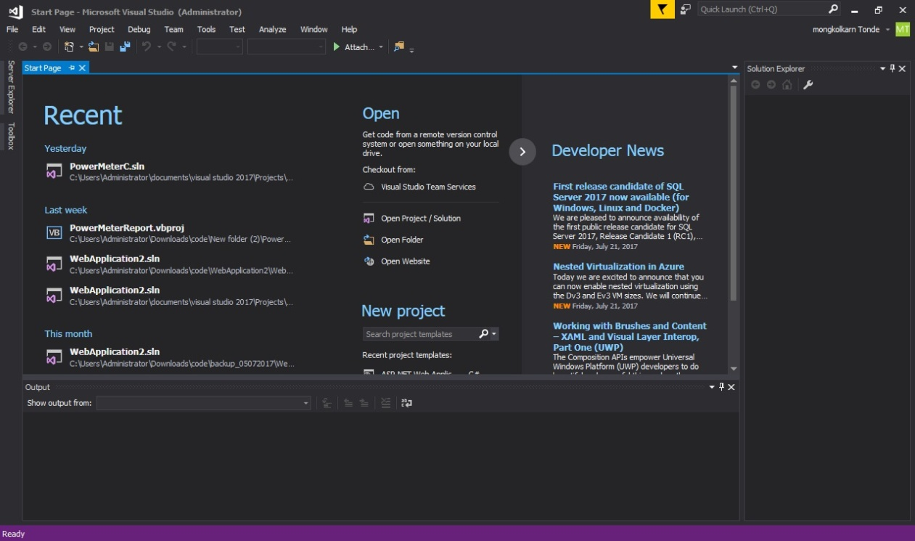

Slide 19
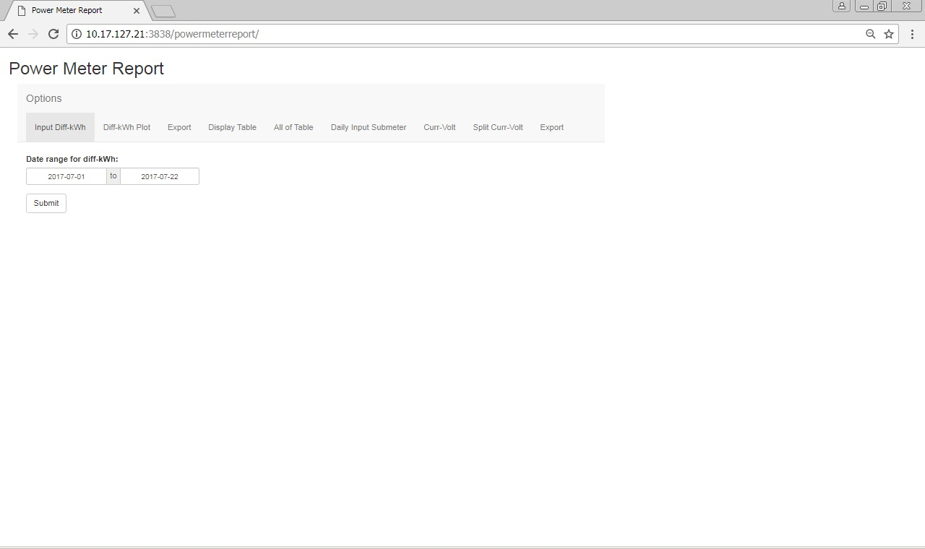
USER INTERFACE

Slide 20
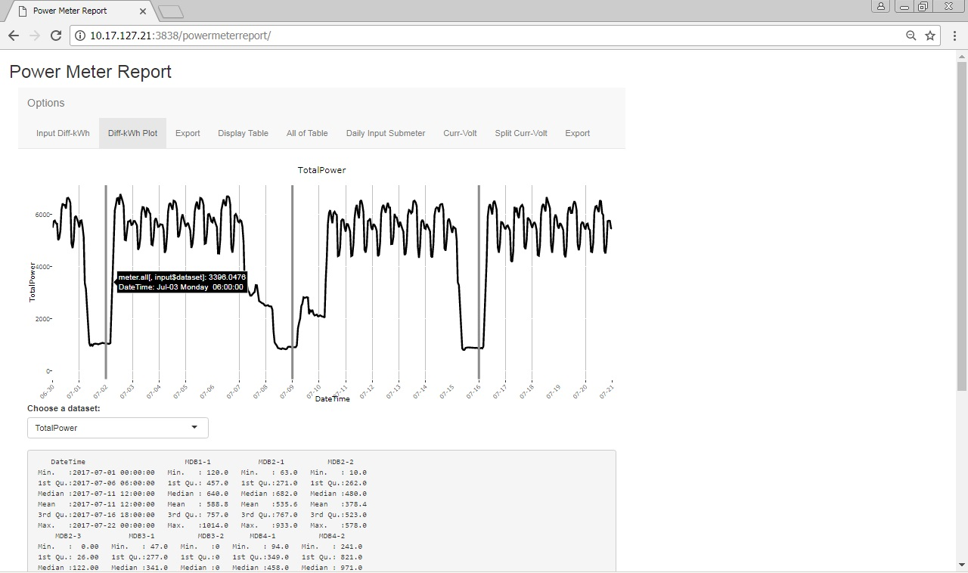
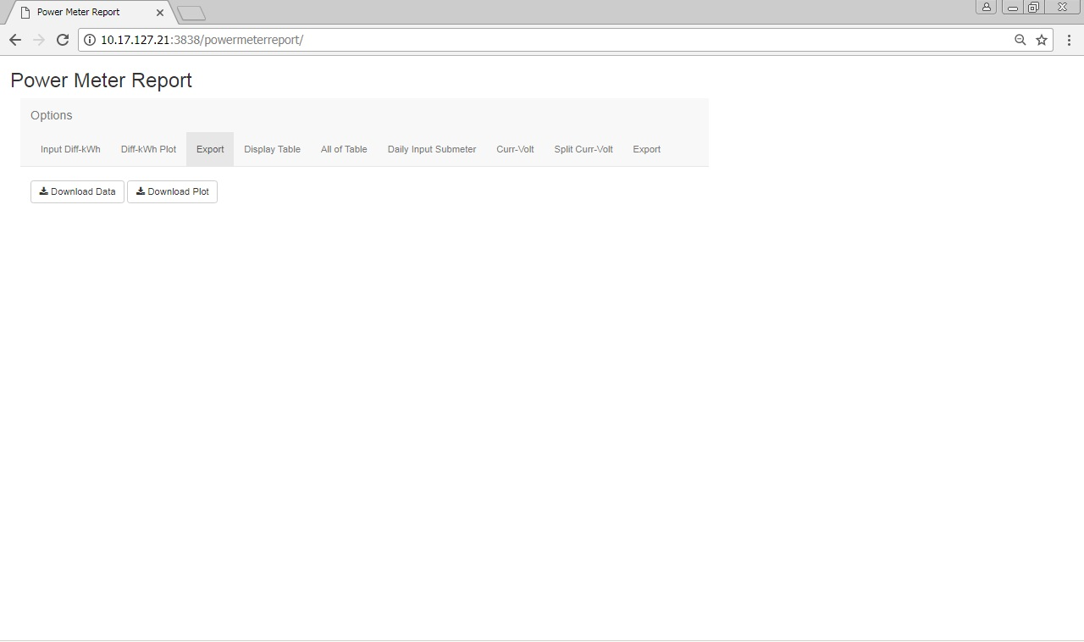
WEB APP USING & FEATURES

Slide 21
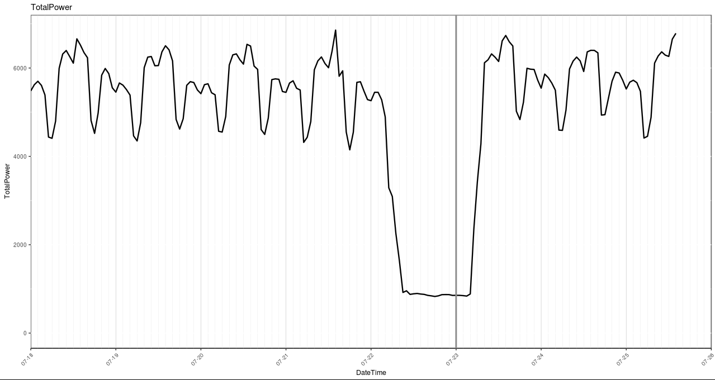
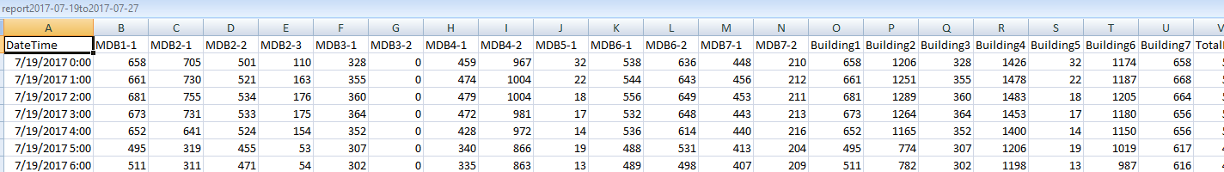
WEB APP USING & FEATURES

Slide 22
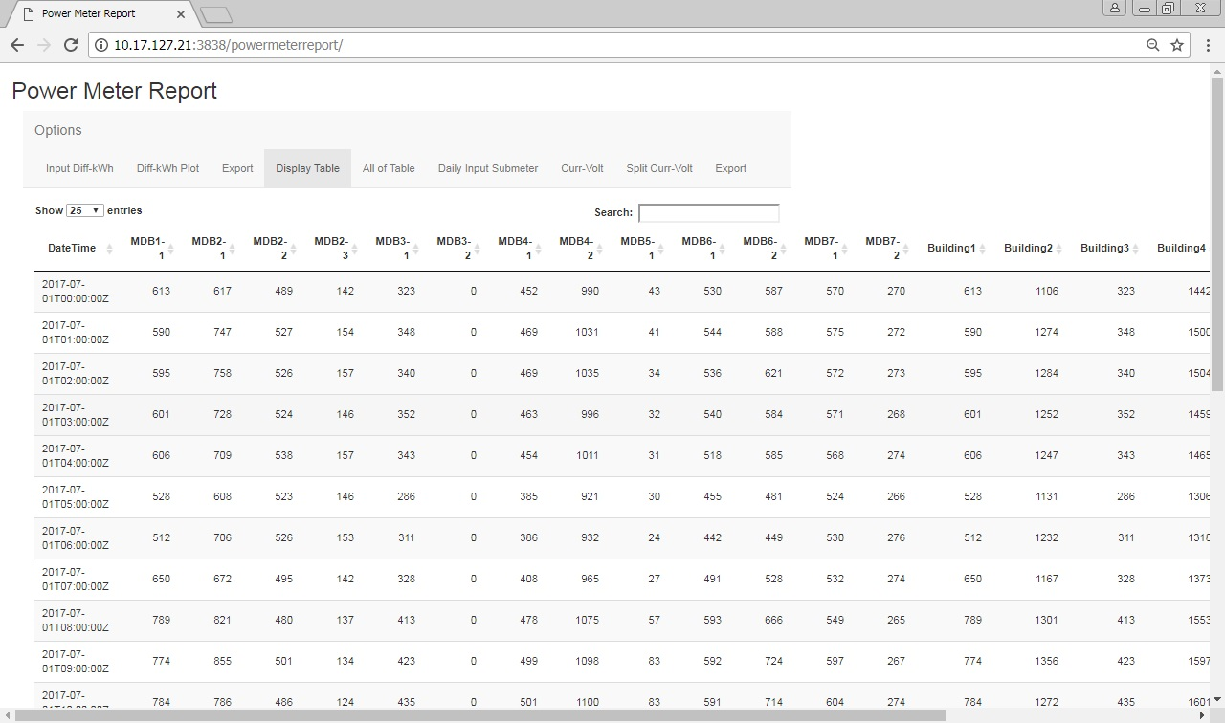
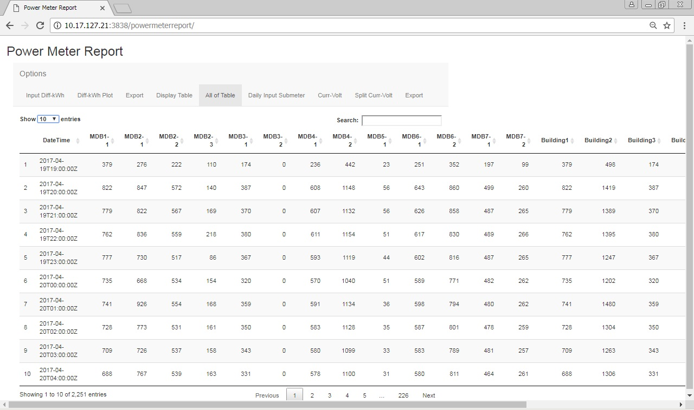
WEB APP USING & FEATURES

Slide 23
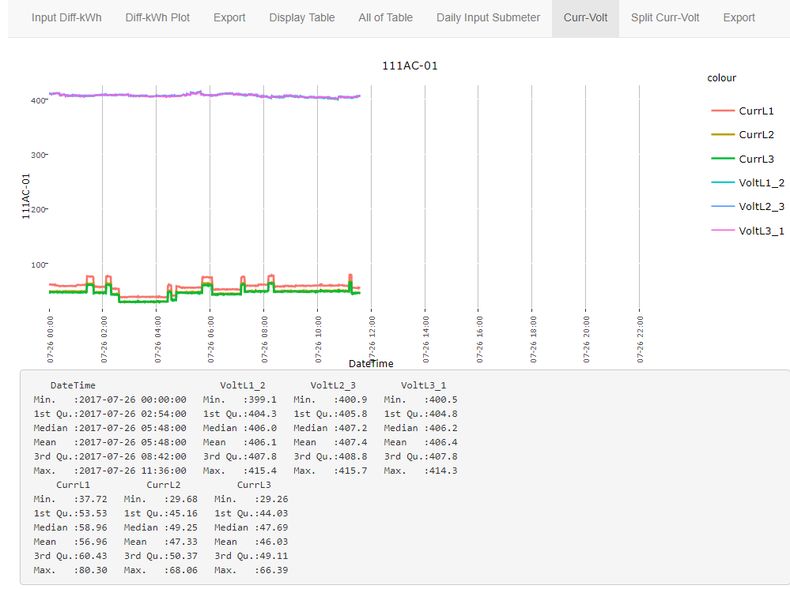
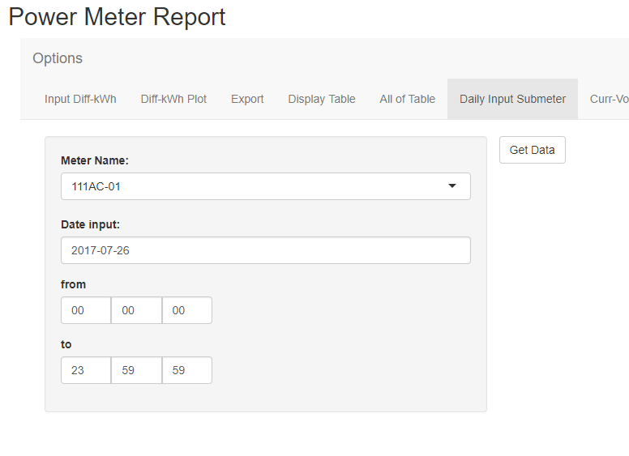
WEB APP USING & FEATURES

Slide 24
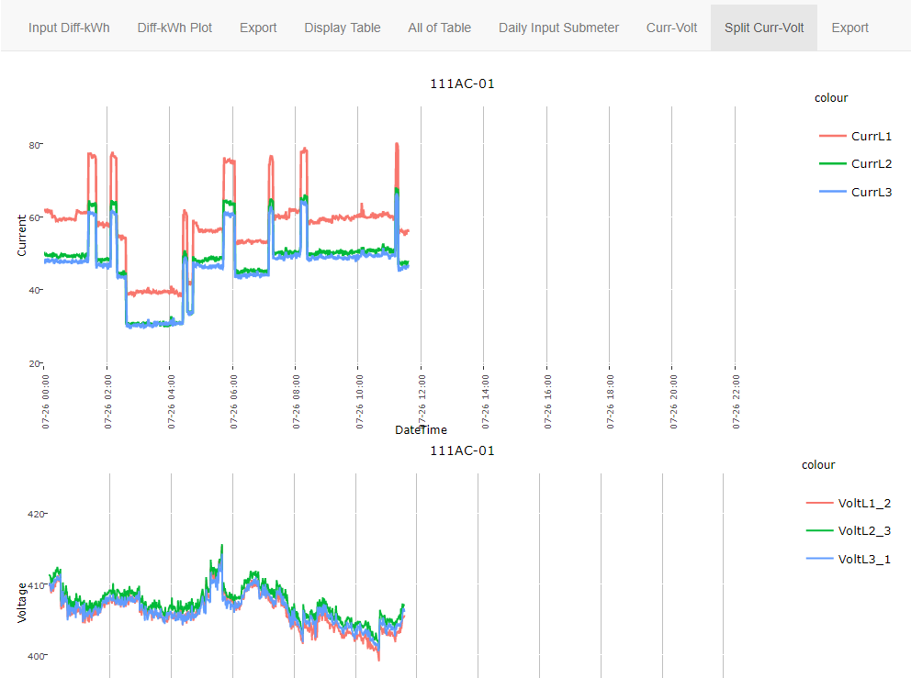
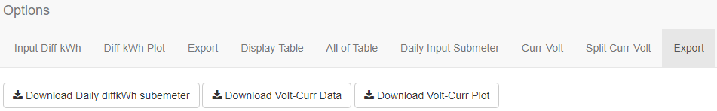
WEB APP USING & FEATURES
GO TO WEB

Slide 25
TIMELINE
General Training
Plan & Design
Get new requirements
Simulate Server
Fix from feedback
Presentation
01 Jun
01 Jul
27 July
Get requirements
Meeting with PE Department
Design
User testing
Install to server
Work in process

Slide 26
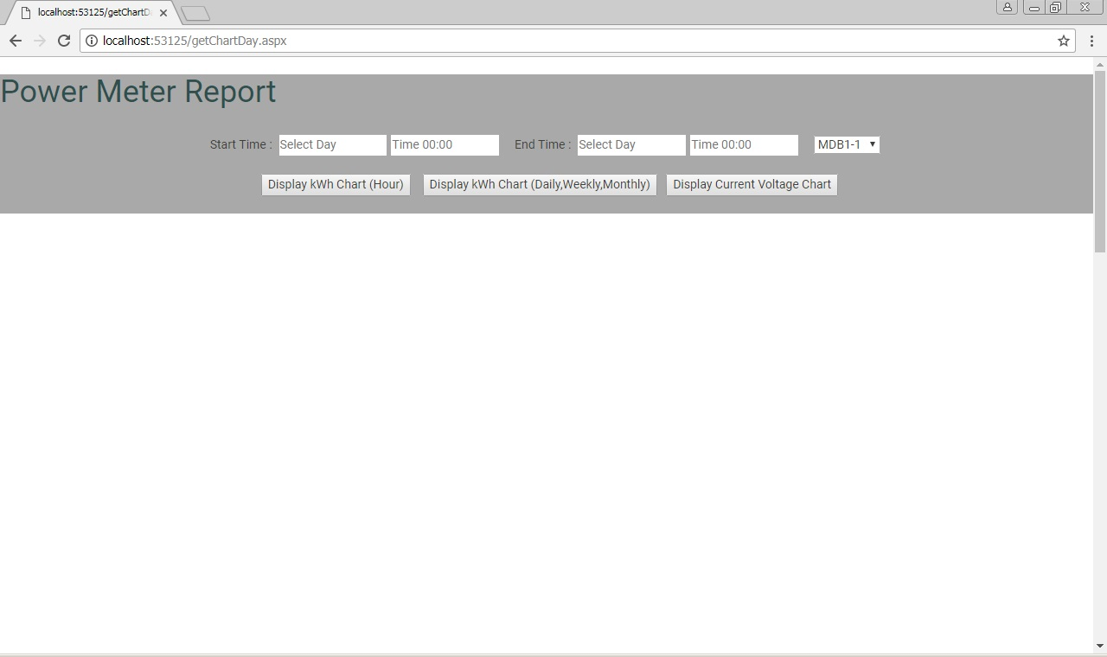
IN ADDITION, From main work.

Slide 27
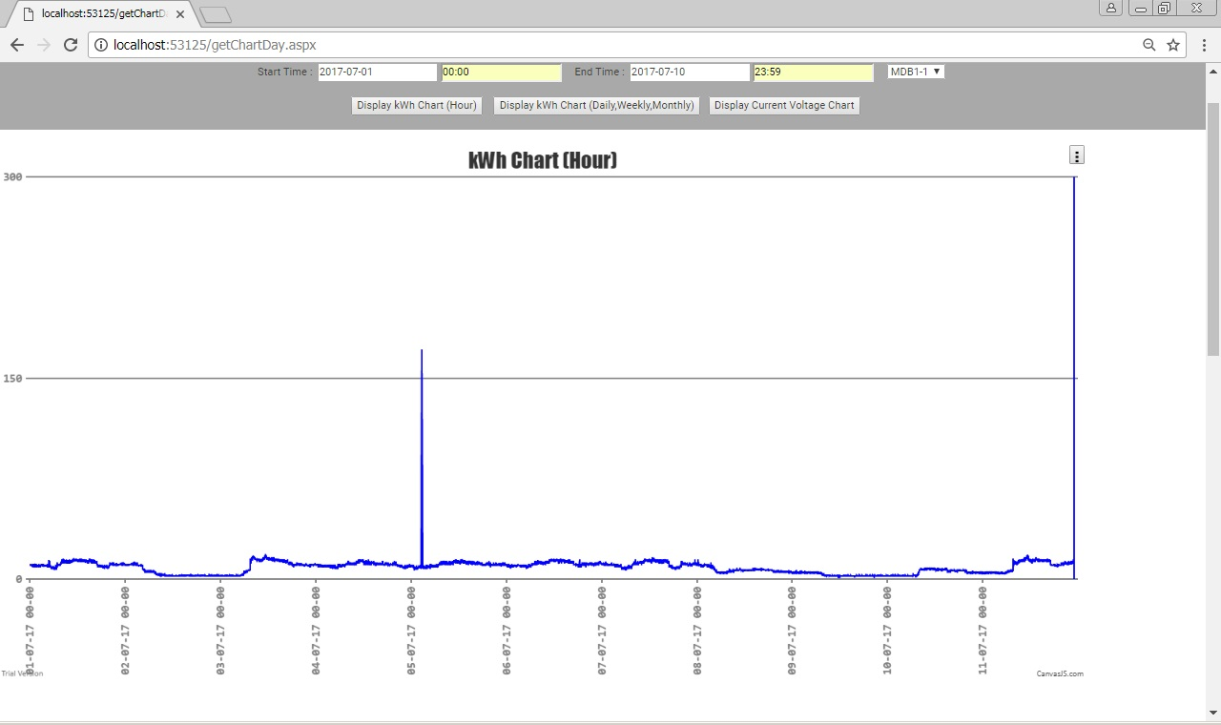
IN ADDITION, From main work.
Electrical Consumption (kWh)

Slide 28
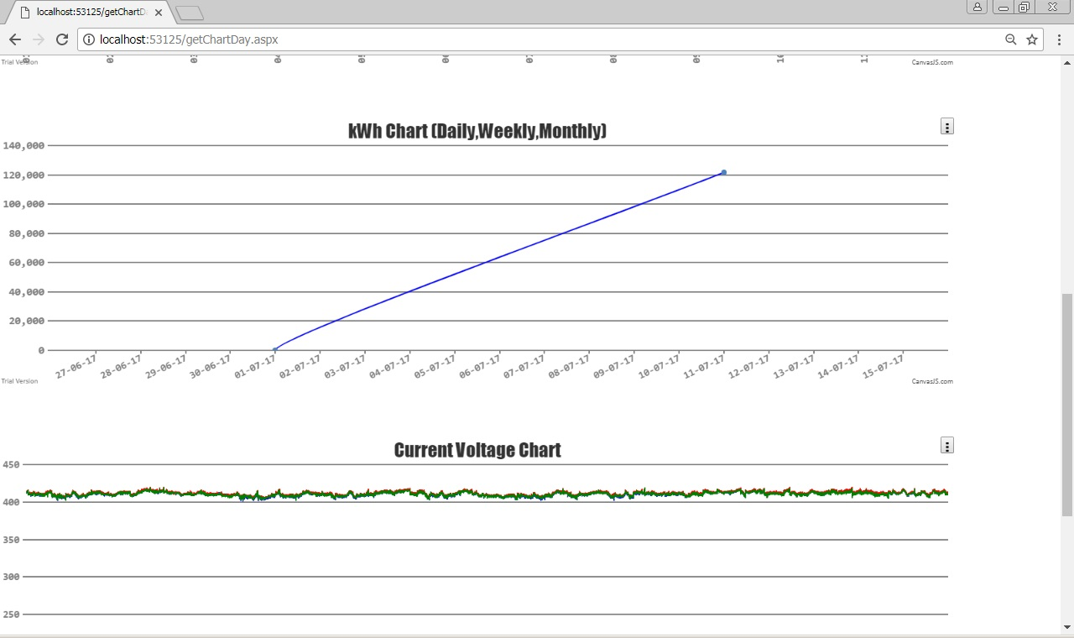
IN ADDITION, From main work.

Slide 29
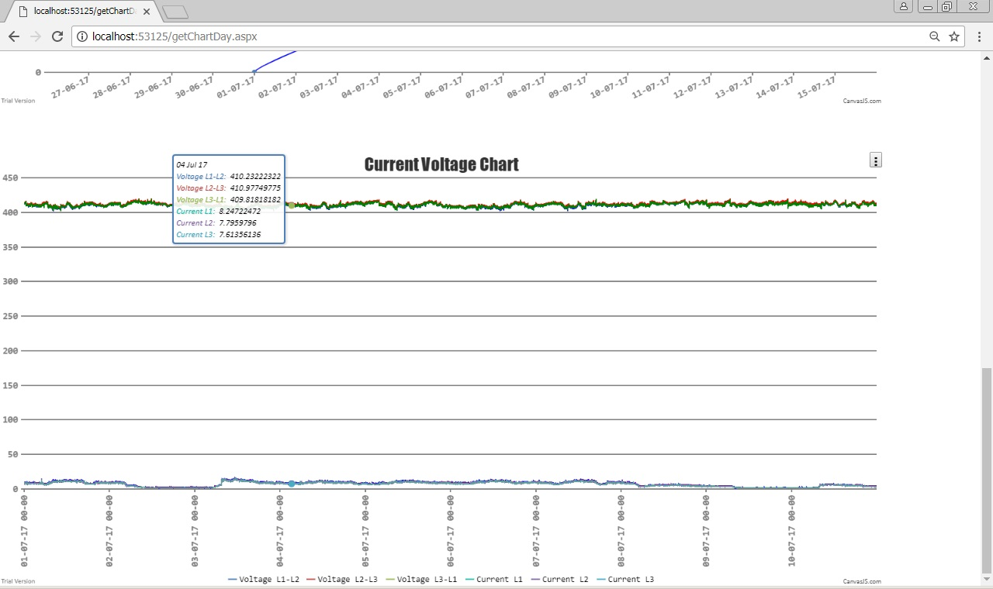
IN ADDITION, From main work.
Current (A) & Voltage (V) Chart

Slide 30
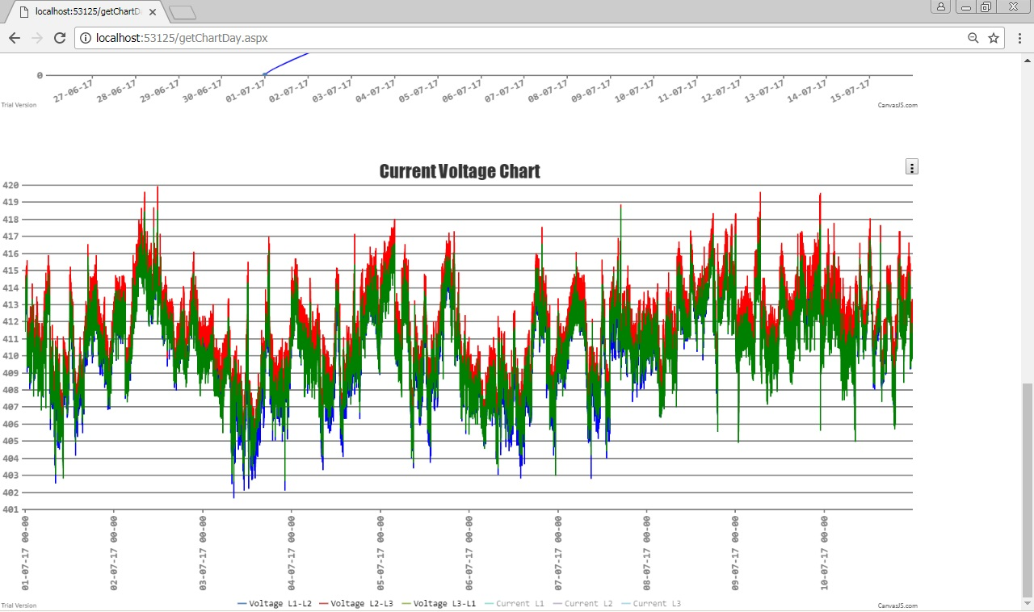
IN ADDITION, From main work.
Voltage (V)

Slide 31
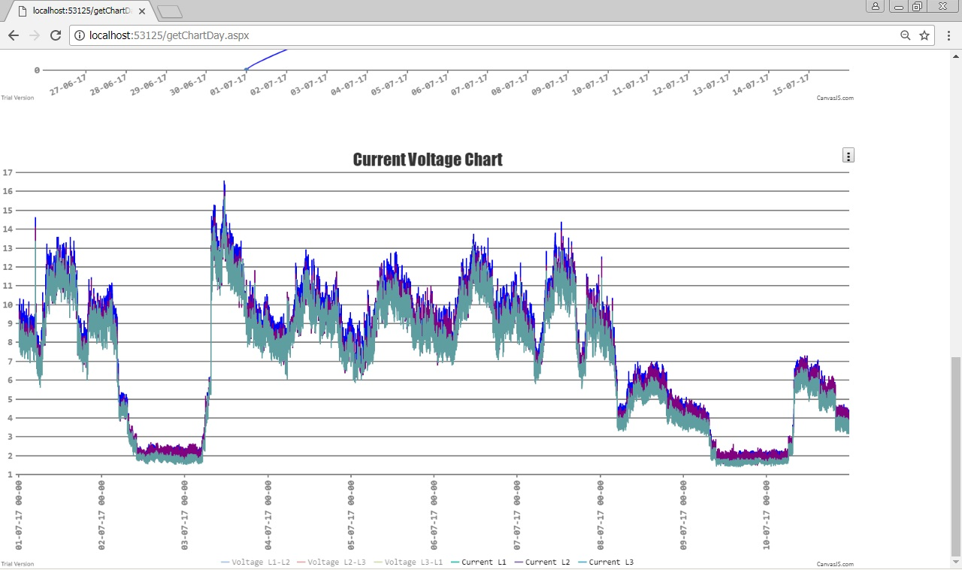
IN ADDITION, From main work.
Current (A)

Slide 32
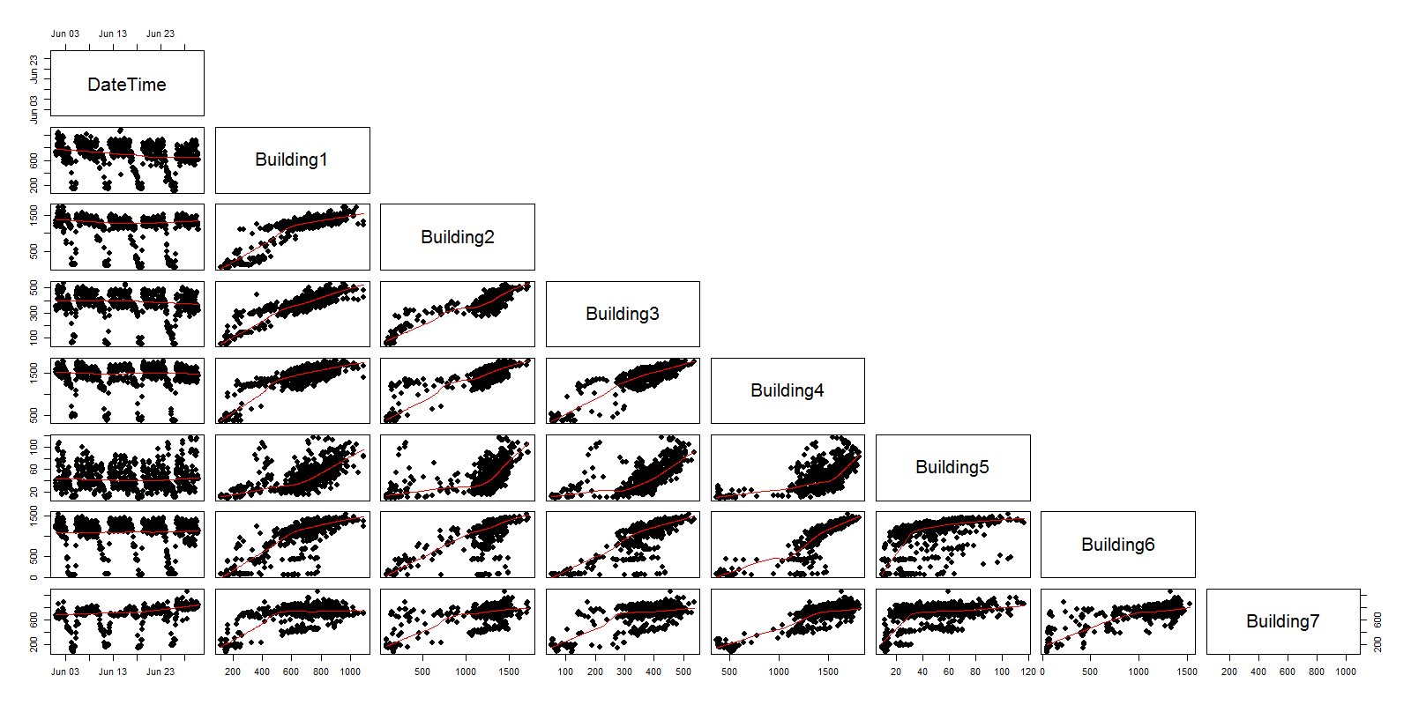
IN ADDITION, From main work.
Analysis & Visualization

Slide 33
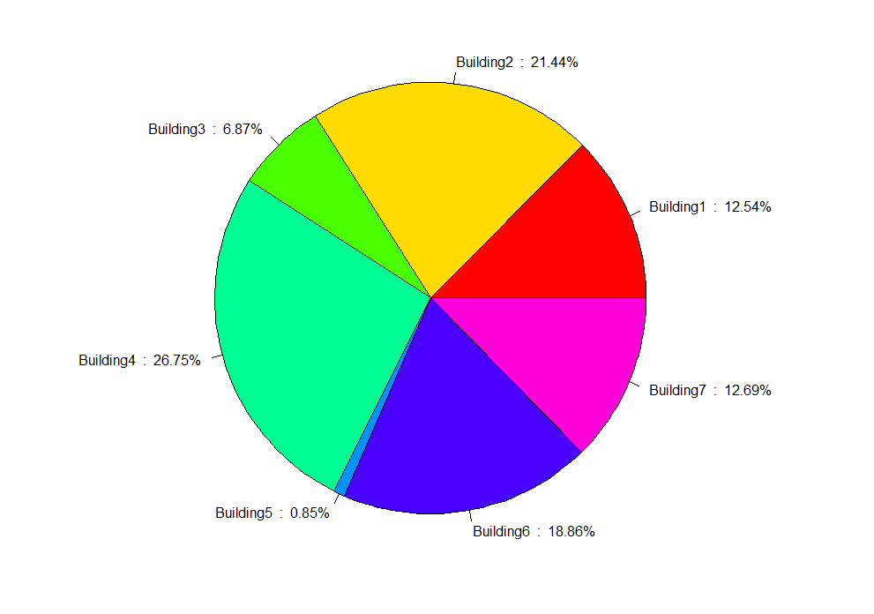
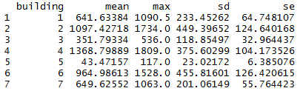
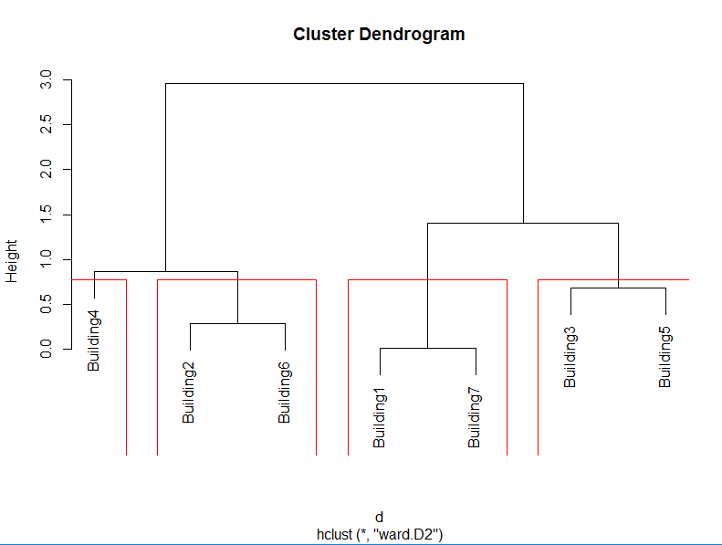
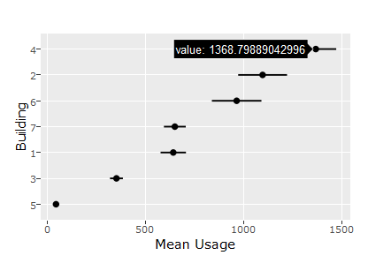
IN ADDITION, From main work.

Slide 34

BENEFITS
LOTS of LEARNING
To
# Better solution skills.
# Work as a team. # Friendship.
# The importance of going by the book.
# Be on time.
# Be concentrated.
# Realize about safety.
# Apply concept in practical to real life including career path.

Slide 35




Slide 36

THANK YOU SIR

